Slide 1






Lecture 25:
Life Cycle Methods
Course - Web Development - II
-By
Instructor Name
‹#›
welcome@krmangalam.edu.in
Sohna Road,Gurugram,Haryana 122103

Slide 2

| Table of Contents
Life cycle methods
Mounting
Updating
Unmounting
References.
The End.
‹#›

Slide 3
| Life Cycle Methods - Class Components
In React Class Components, Lifecycle Methods are functions that run at different stages of a component’s life.
React lifecycle has three phases:
Mounting (Component is created and added to DOM)
Updating (When state or props change)
Unmounting (Component removed from DOM)
‹#›

Slide 4
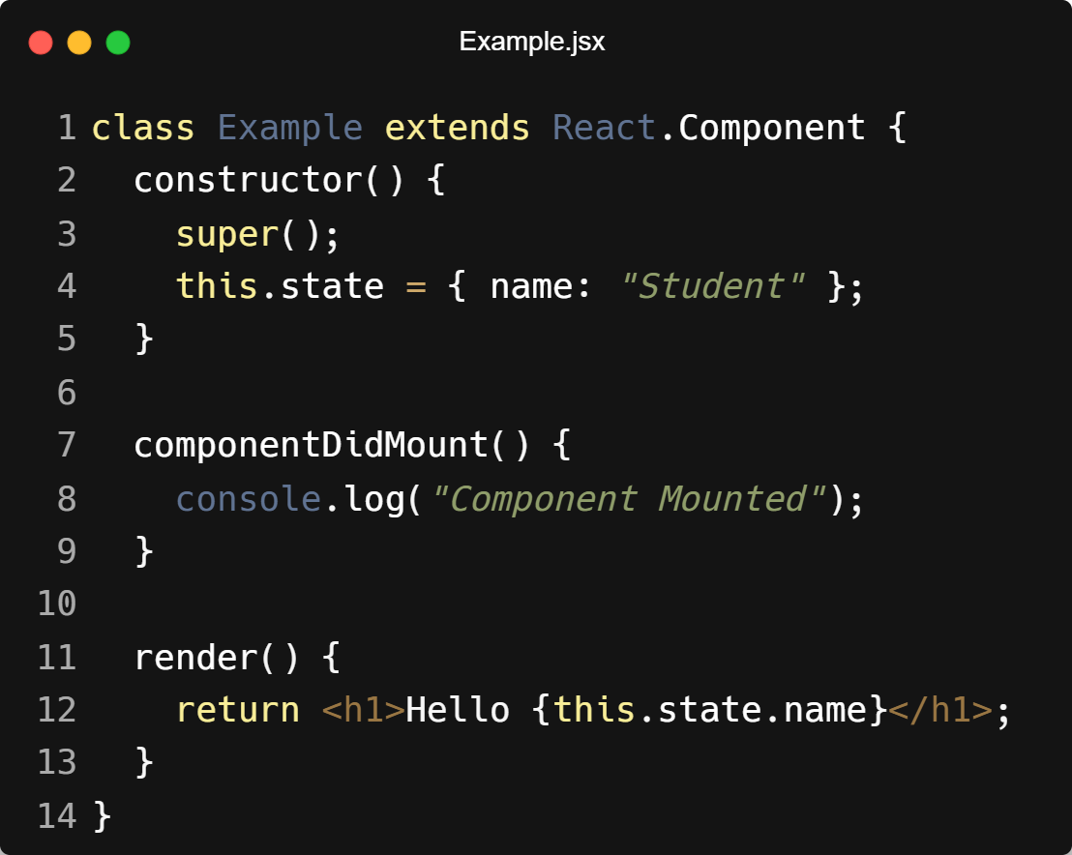
| Life Cycle Method - Mounting
constructor() → used to initialize state
render() → returns JSX (UI)
componentDidMount() → runs after the component is displayed (used for API calls)
‹#›

Slide 5
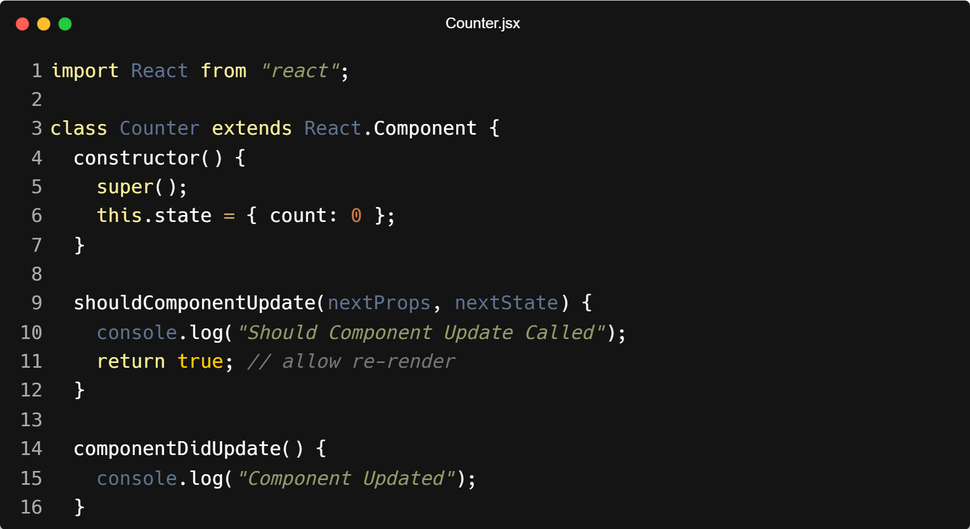
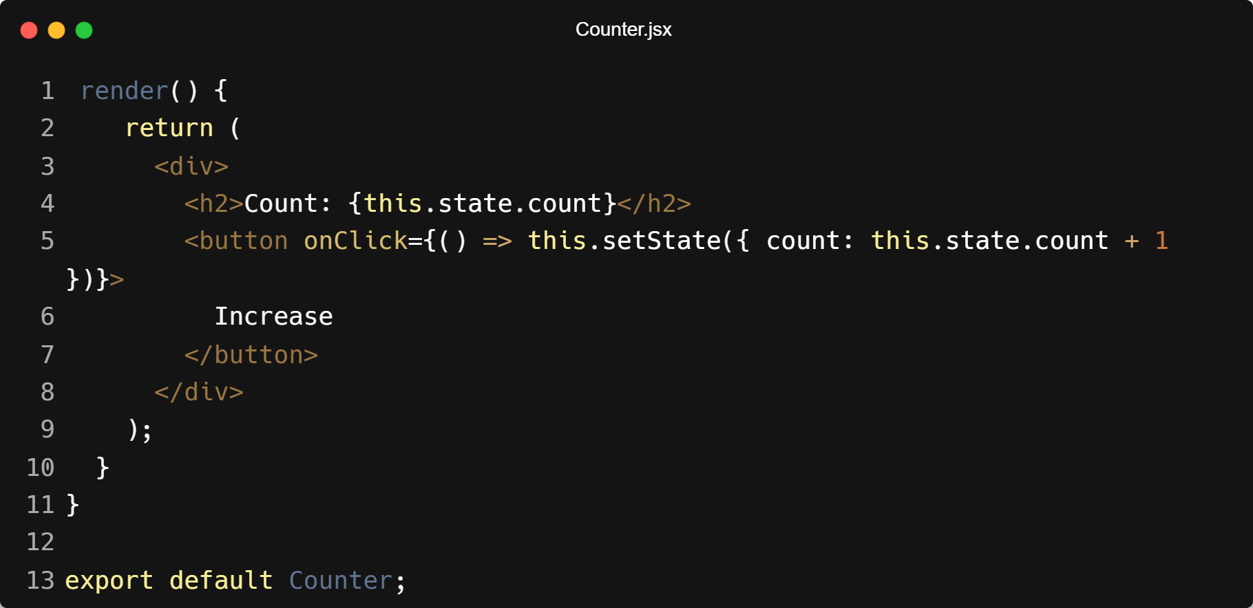
| Life Cycle Method - Updating
shouldComponentUpdate() → decides whether to re-render
componentDidUpdate() → runs after the update
‹#›

Slide 6
| Life Cycle Method - Updating
How it works
Click Increase button
setState() changes the state
shouldComponentUpdate() runs → decides if component should re-render
render() runs again
componentDidUpdate() runs after the UI updates
‹#›

Slide 7
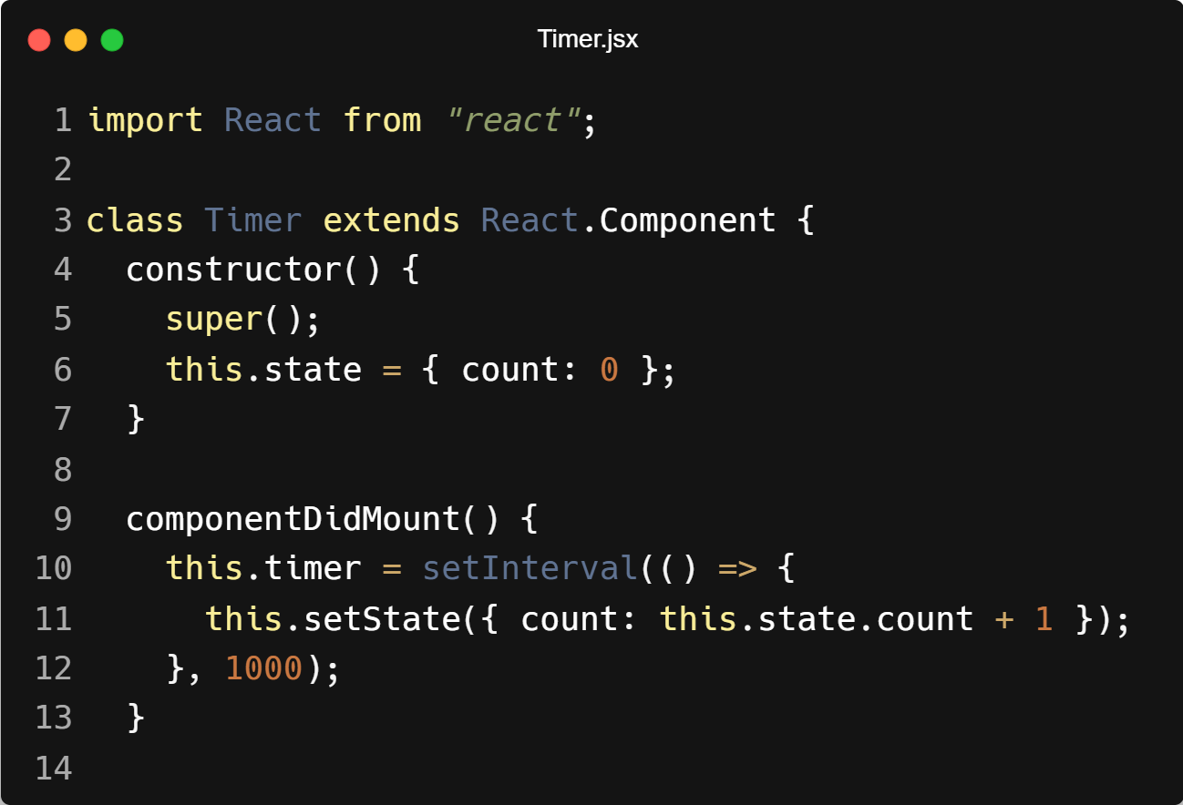
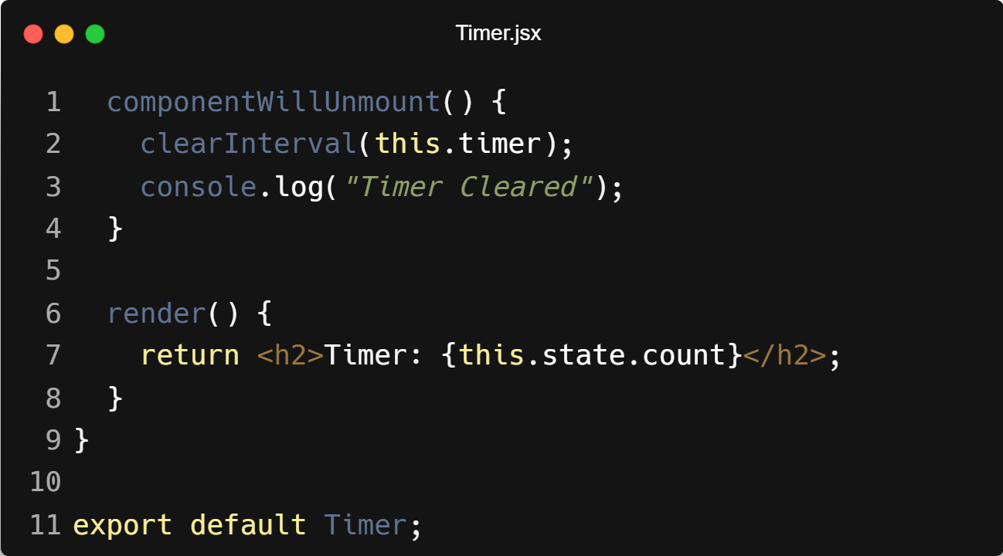
| Life Cycle Method - Unmounting
componentWillUnmount() → used to clear timers, remove events, etc. code example.
‹#›

Slide 8
| Life Cycle Method - Unmounting
How it works
componentDidMount() → starts a timer
Timer increases count every second
When the component is removed from the DOM
componentWillUnmount() runs → clears the timer
‹#›

Slide 9
| Drawbacks of Class Components in React
Complex Syntax Class components use class, constructor, this, and render(), which makes them harder to read and write.
Use of this Keyword Developers must use this.state, this.props, and bind methods, which can be confusing.
More Boilerplate Code They require more code compared to functional components.
Hard to Reuse Logic Logic sharing between components is difficult compared to Hooks.
Lifecycle Methods Replaced by Hooks In modern React, lifecycle methods like componentDidMount, componentDidUpdate, and componentWillUnmount can be handled using the useEffect hook in functional components.
‹#›

Slide 10
| References
MDN Web Docs : Comprehensive and official documentation for JS. 🔗https://developer.mozilla.org/en-US/docs/Web/JavaScript
W3Schools – JS Tutorial : Beginner-friendly JS tutorials with examples and interactive editors. 🔗 https://www.w3schools.com/js/
react.dev - A comprehensive, tutorial-style website that deeply explores core React concepts, including components, state, effects, and hooks, through interactive examples and in-depth explanations.
🔗https://react.dev/
‹#›

Slide 11
Thanks
For
Watching
Course - Web Development - II
‹#›
welcome@krmangalam.edu.in
Sohna Road,Gurugram,Haryana 122103

